Slide 1

City Of Changwon-Si
Tourism Campaign
2024.05.20 / LEE CHANG YEOB / 20117669

Slide 2
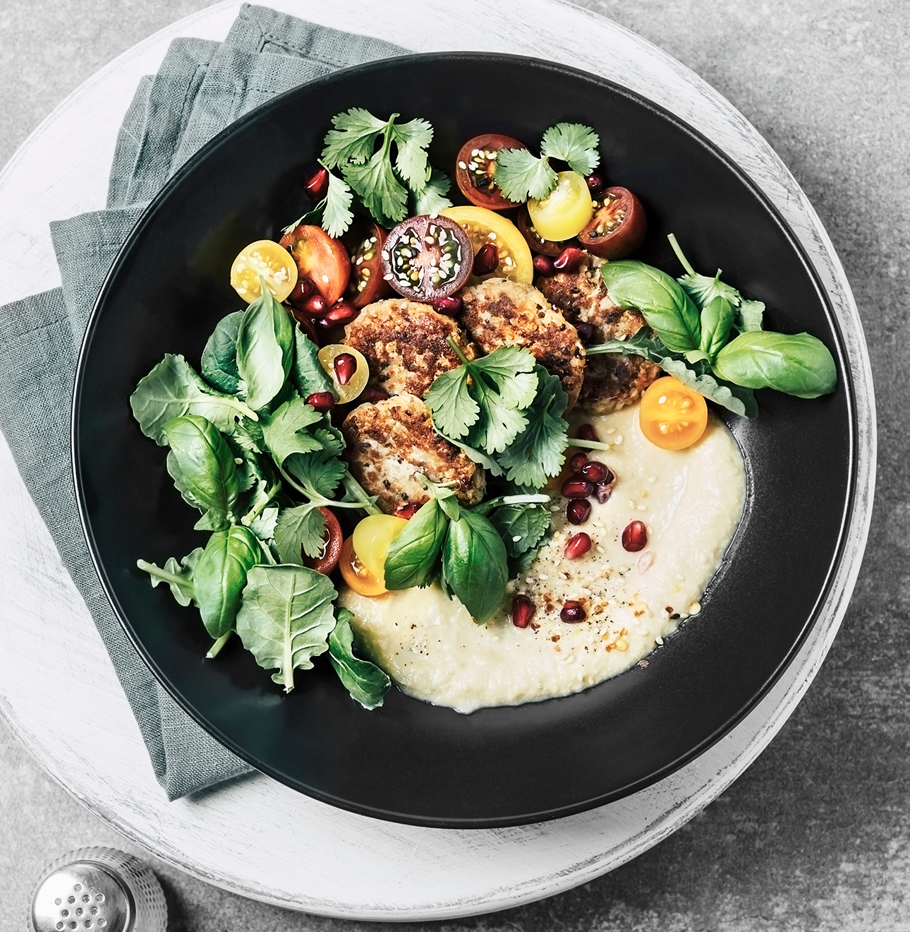
City Slogan
Changwon Slogan

Slide 3

Changwon Slogan
Plus CHANGWON
Plus Changwon
flexibility to add anywhere
the possibility to add anything
the future value of Changwon

Slide 4

Changwon Character
피우미 (Fiumi)
Fiumi
it will blossom a new hope in Changwon
cute mascot containing cherry blossoms.

Slide 5
Famous Places
Changwon Places

Slide 6
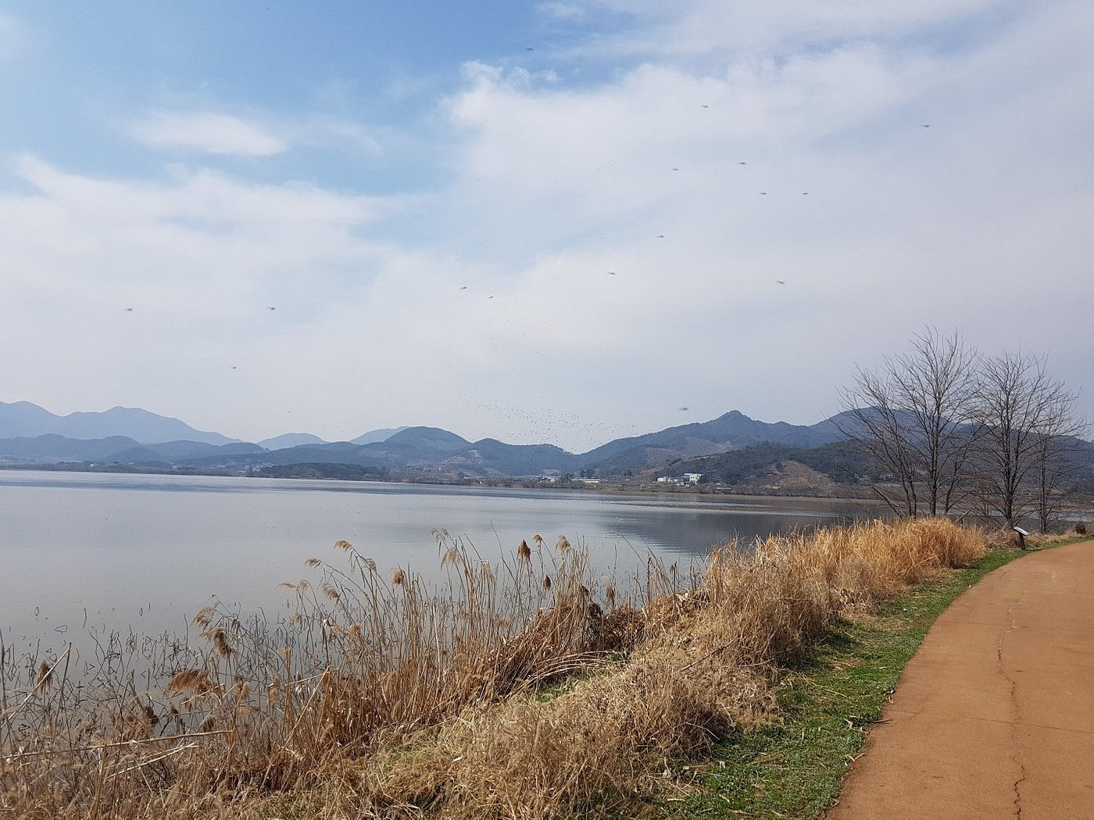
Famous Places
Junam Reservoir
Junam Reservoir
the largest migratory
bird destination in the East.
variety of migratory birds

Slide 7
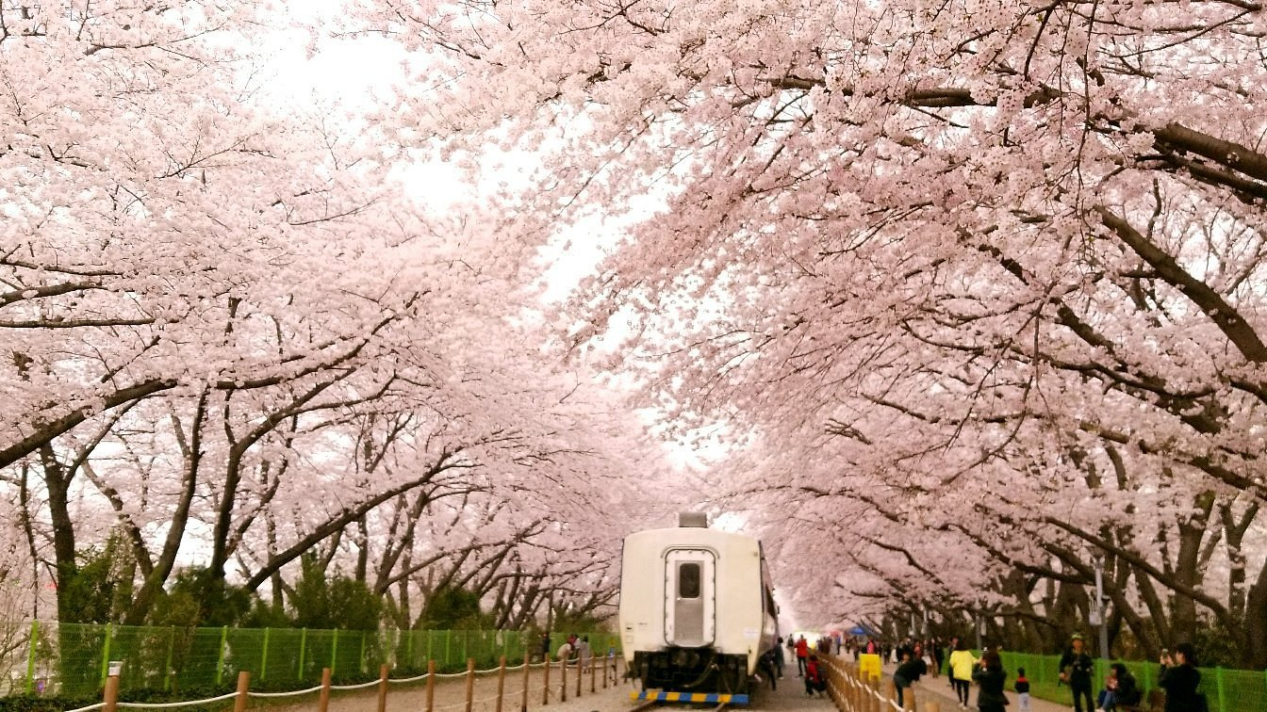
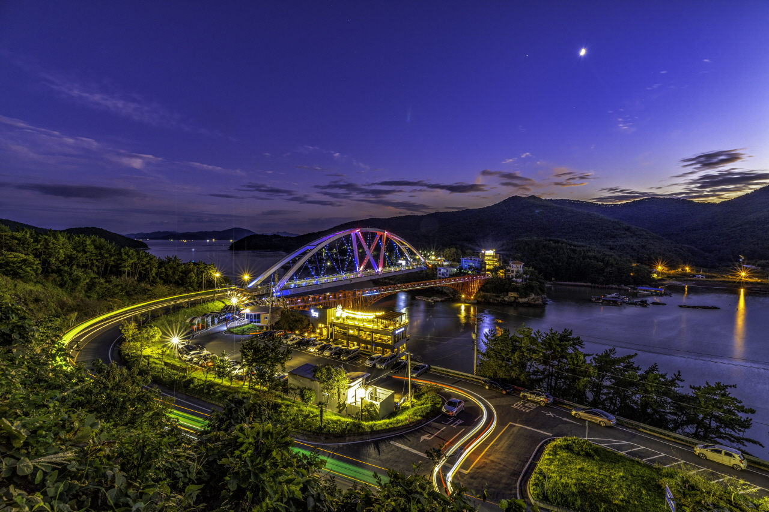
Famous Places
Cherry Blossom Road at Gyeonghwa Station & Bridge on the Kwai River
Gyeonghwa Station
good place to go in spring
closed station's railway
Bridge on the Kwai River
- good night view

Slide 8
Famous Food
Changwon Foods

Slide 9
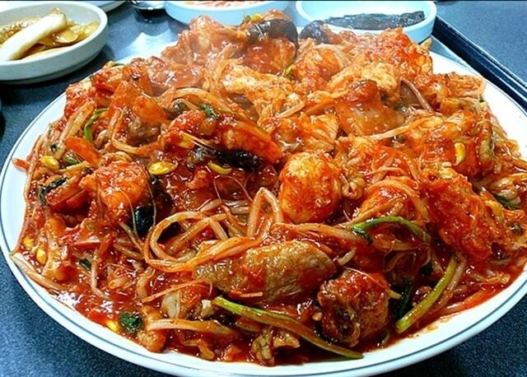
Famous Food
Aguijjim
Aguijjim
steamed dish made from monkfish
it originated in Changwon City

Slide 10
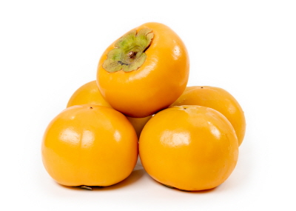
Famous Food
Sweet Persimmon
Sweet Persimmon
No. 1 city in the country
that grows sweet persimmons
have a 100-year-old
sweet persimmon tree

Slide 11
Famous Events
Changwon Events

Slide 12
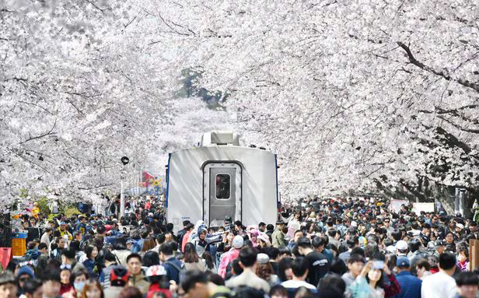
Famous Events
Jinhae Gunhangje Festival
Jinhae Gunhangje Festival
Jinhae Cherry Blossom Festival
since 1963

Slide 13
Thank You :D

